Slide 1
Samuel E. Shull Middle School Physical Education/Health

Slide 2
The team
Answer the question, “Why are we the ones to solve the problem we identified?”
Mrs. Perez
Email: ceciperez@paps.net
Teacher Page with Google Classroom Codes

Slide 3
Welcome
Tech Support
Classroom Rules/Attendance
Virtual Learning Format
Grading
Conclusion

Slide 4
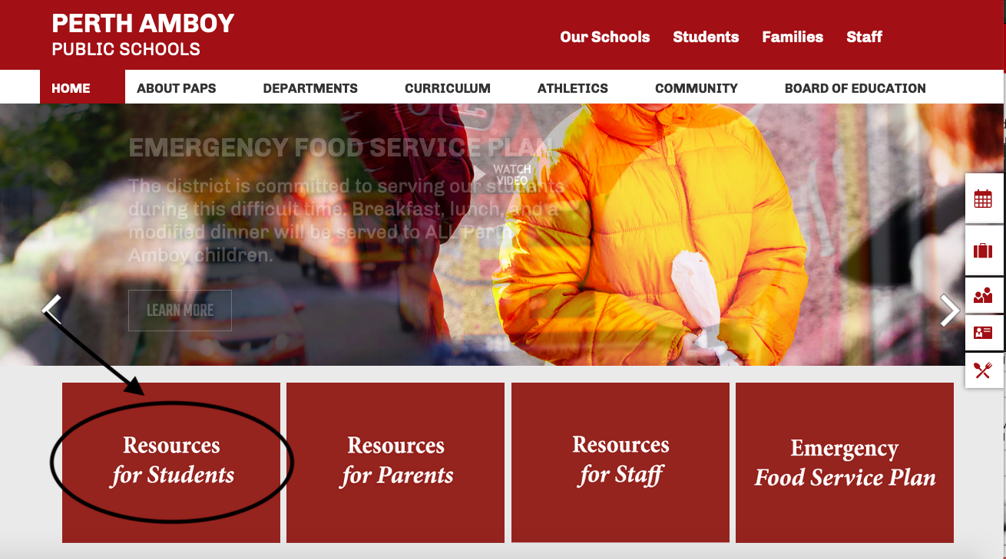
Trouble with your student device?

Slide 5
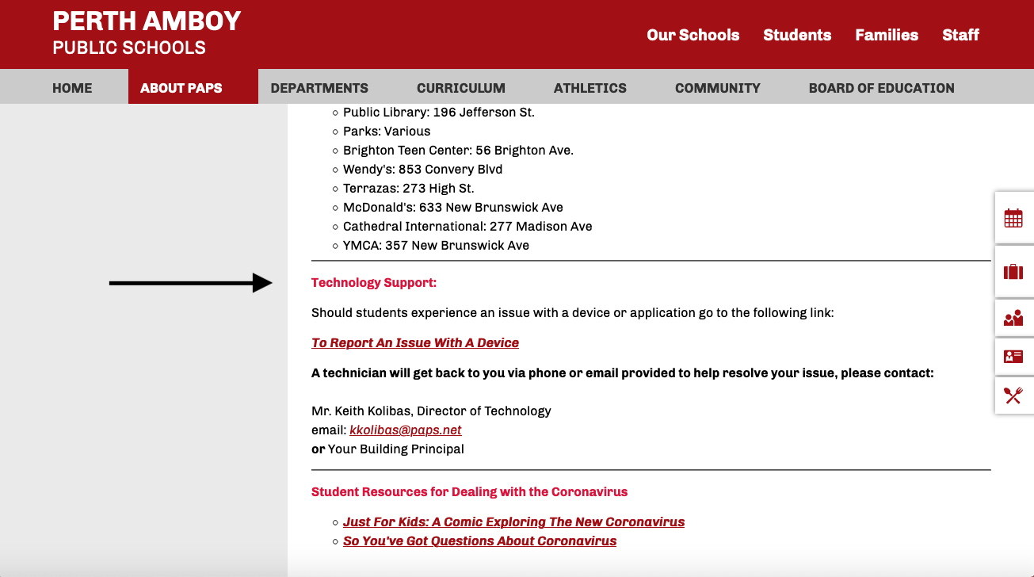

Slide 6
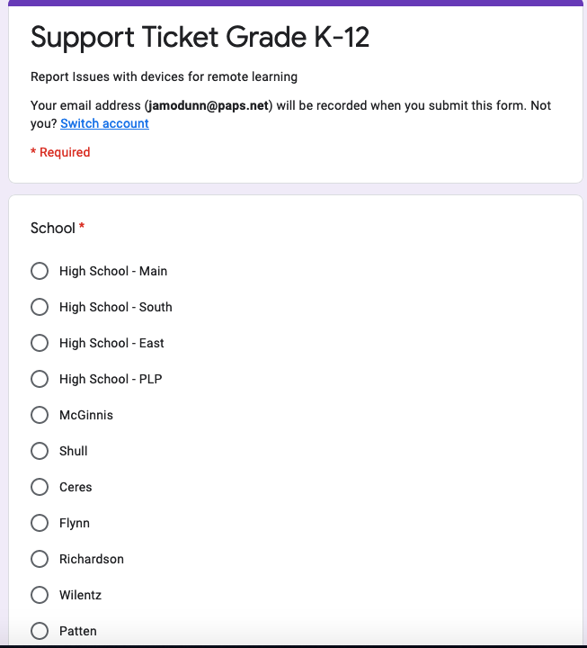
Perth Amboy Technology Support for Student Devices

Slide 8
Classroom Rules/Expectations
Attendance taken every period
Grace period for logging in/out
All assignments posted and submitted in GC
*If student gets logged off, try to sign back on. If they cannot sign back on, send me an email and continue working on the daily assignment.
**If the teacher gets logged off, look for a message in GC and continue working on the daily assignment

Slide 9
Virtual Physical Education Format
Mindfulness/ Warm-up
Activity (Virtual Learning Activity Page)
Cool Down/Journal Entry

Slide 10
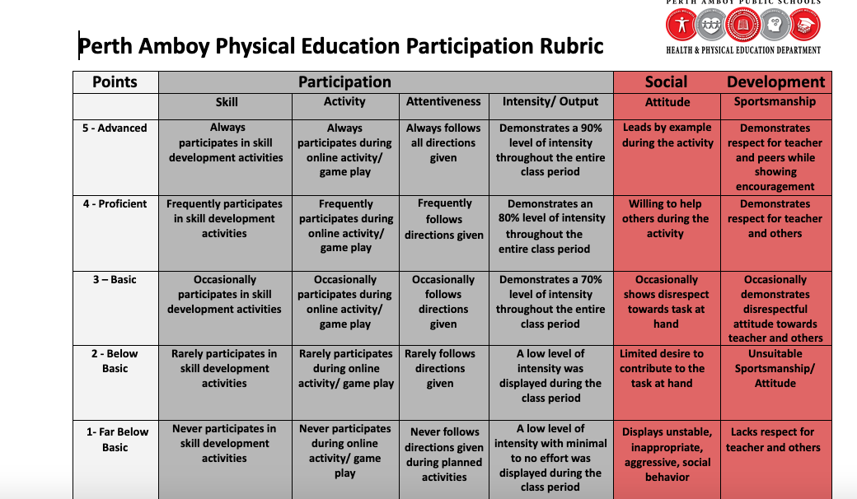
Grading
80% Participation
*Students earn 5 pts per day/ 15 pts cycle
10% Skills (Fitness Testing)
10% Written (Journal/Assessment)

Slide 11
Thank you for your time
*A copy of this presentation will be available on my teacher page

